Slide 1
Jaunt Rural Transit Needs Assessment
Project Overview

Slide 2
Research Team
Jeremy Mattson – Associate Professor, Small Urban and Rural Center on Mobility (SURCOM), North Dakota State University (NDSU)
Jill Hough – Director, SURCOM, NDSU

Slide 3
Study Objectives
Construct demographic profile of the Jaunt service area
Develop a mobility needs index
Describe existing levels of transit service across the study area
Identify base levels of desired transit service and gaps in existing service
Develop recommendations for meeting mobility needs

Slide 4
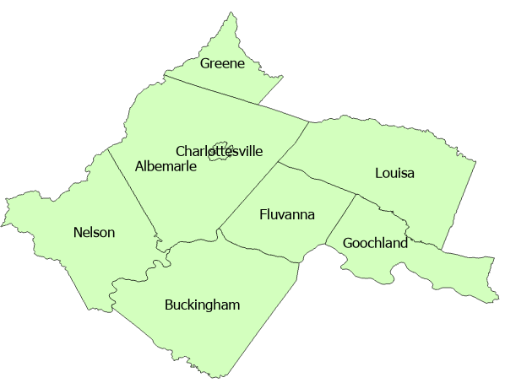
Scope of Study
Counties of Albermarle, Buckingham, Fluvanna, Goochland, Greene, Louisa, Nelson
City of Charlottesville
Local public transportation, human service transportation
Jaunt wants to quantify how much transit services are needed in each of its partner jurisdictions.

Slide 5
Work Plan
Task 1. Stakeholder Involvement
Task 2. Develop a demographic profile and mobility needs index of the study area
Task 3. Describe and evaluate existing levels of passenger transportation services with study area
Task 4. Establish mobility goals and identify service gaps, transit needs, and funding requirements
Task 5. Identify options and recommendations
Task 6. Develop final deliverables

Slide 6
Task 1. Stakeholder Involvement
Project kickoff meeting
Online surveys/interviews
Meeting with preliminary results
Meeting after draft report completed

Slide 7
Task 2. Develop a demographic profile and mobility needs index of the study area
Population density
Demographics
  Older adults (age 65+)
  People with a disability
  Low income
  Households with no vehicle
  Youth (age 10-17)
Mobility Needs Index
Projected population growth

Slide 8
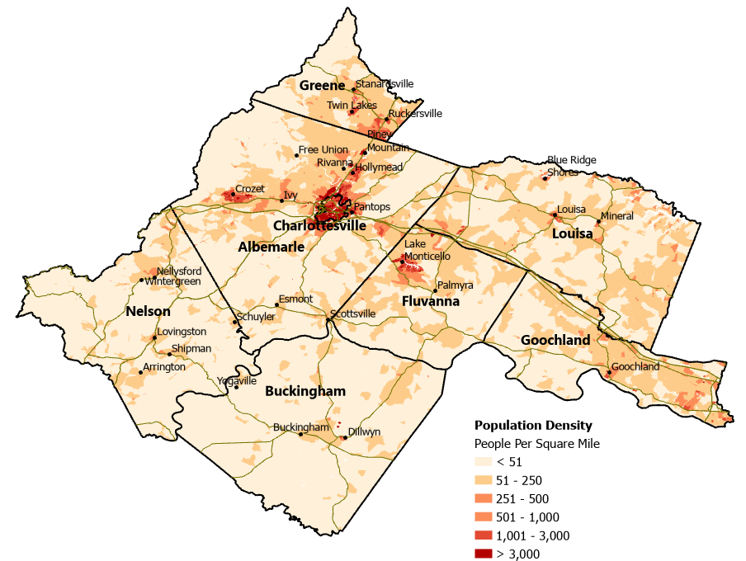
Population Density

Slide 9
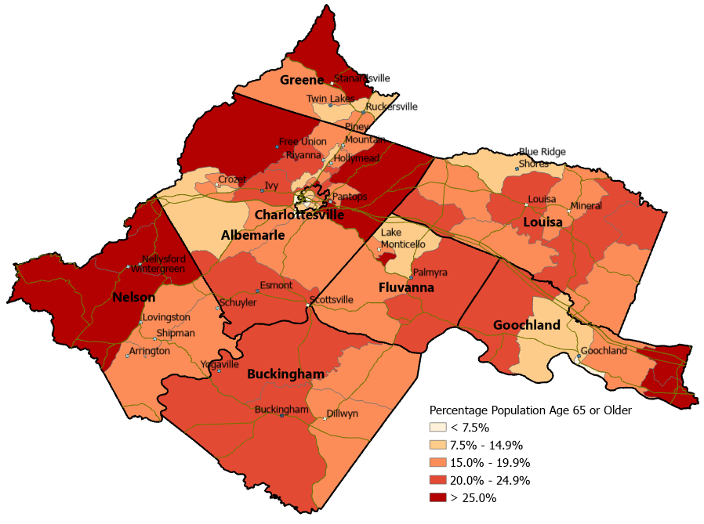
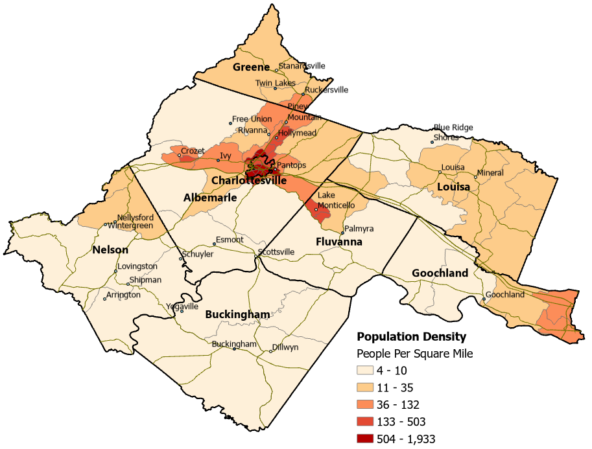
Older Adult Population

Slide 10
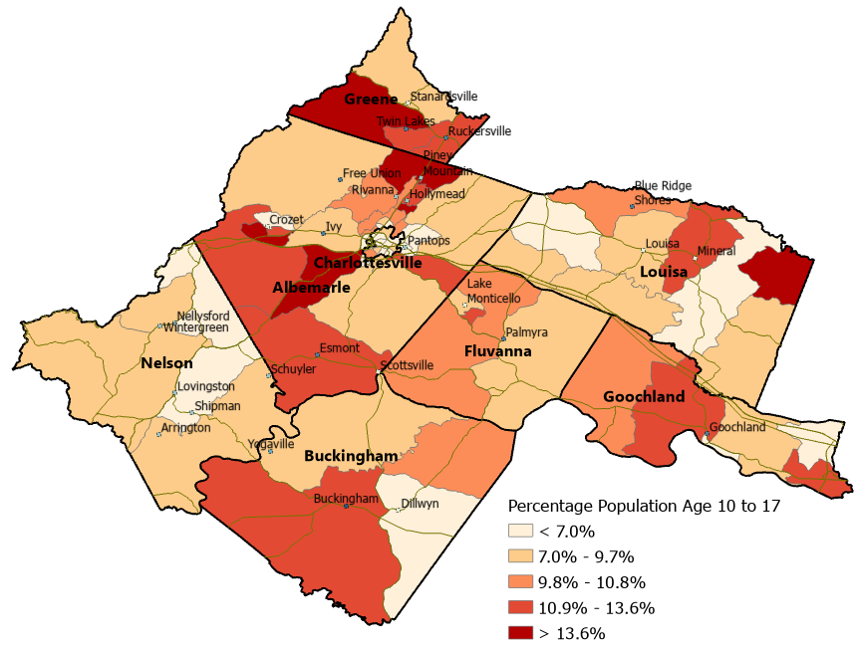
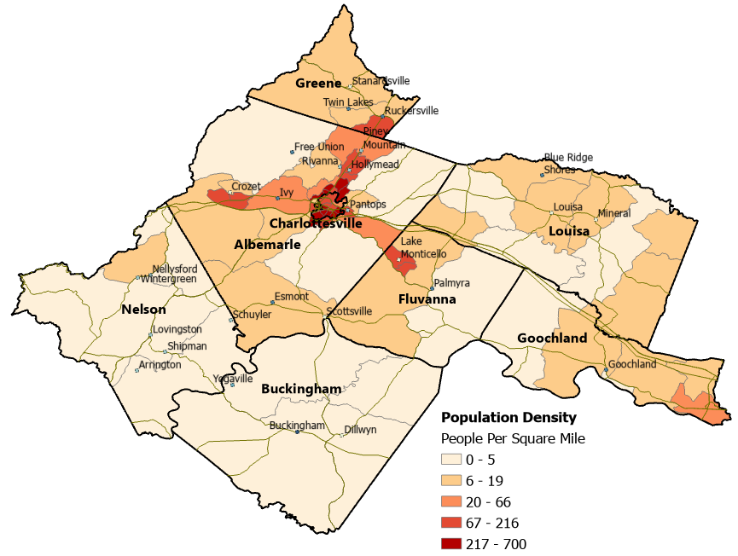
Youth Population

Slide 11
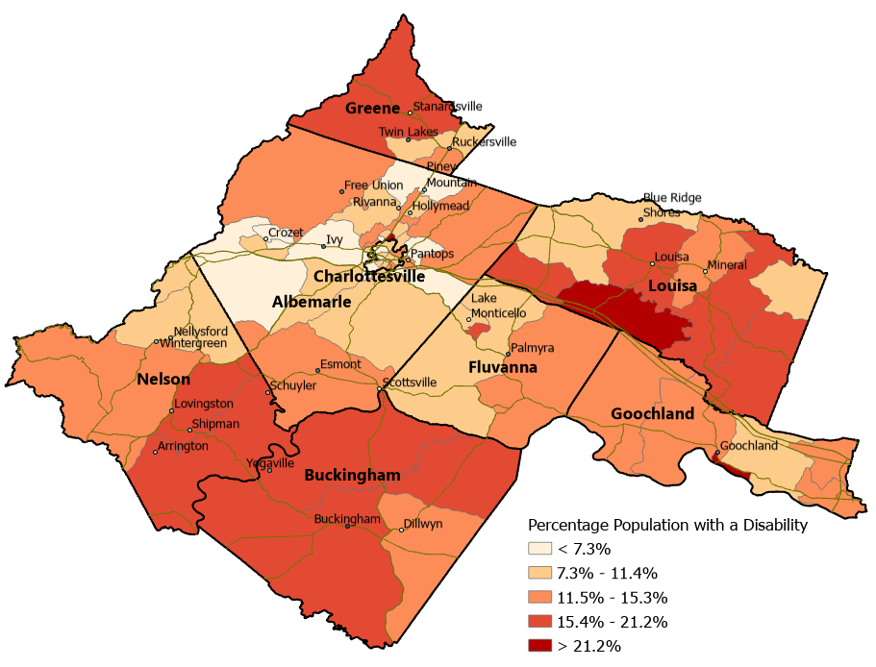
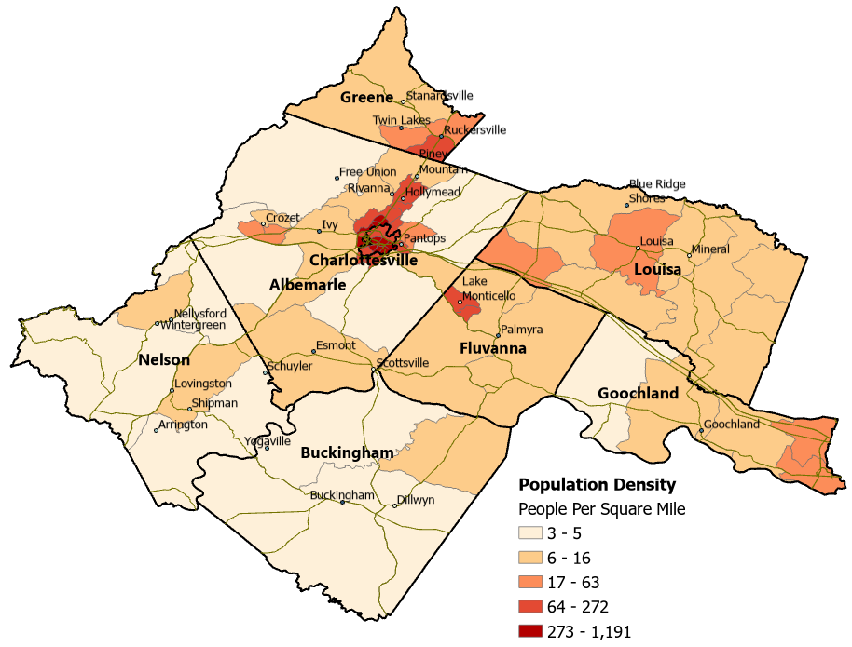
Population with a Disability

Slide 12
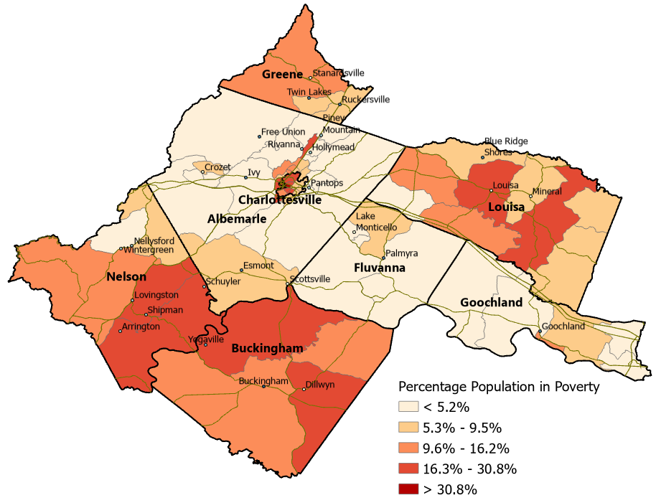
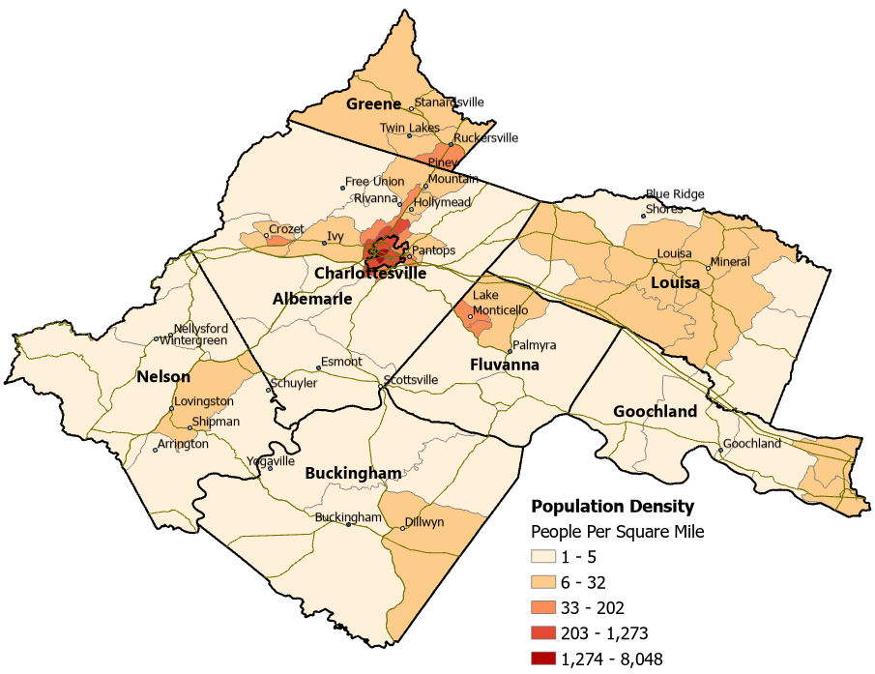
Low-Income Population

Slide 13
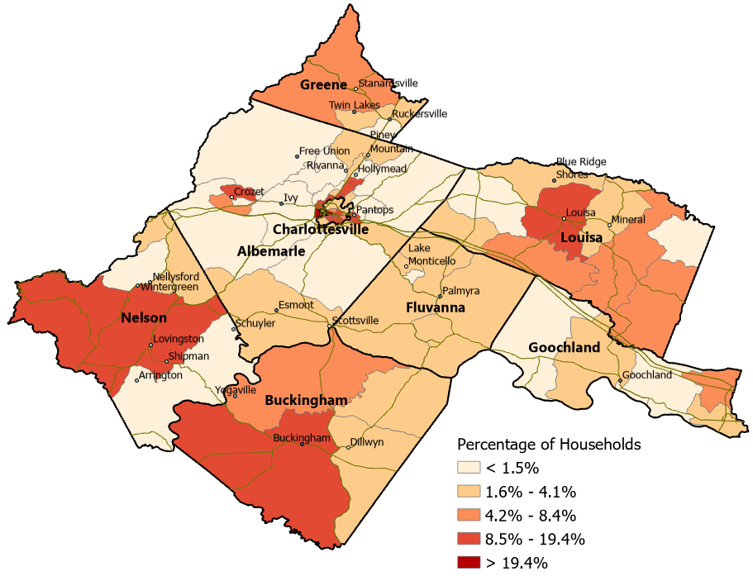
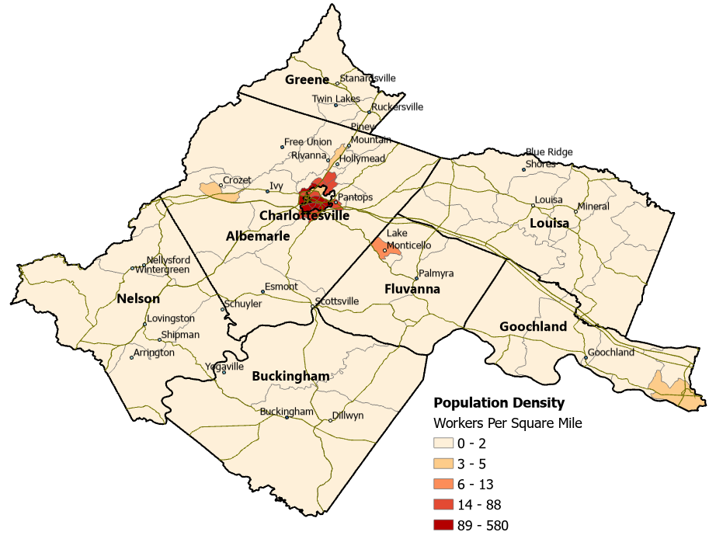
Households with No Vehicles

Slide 14
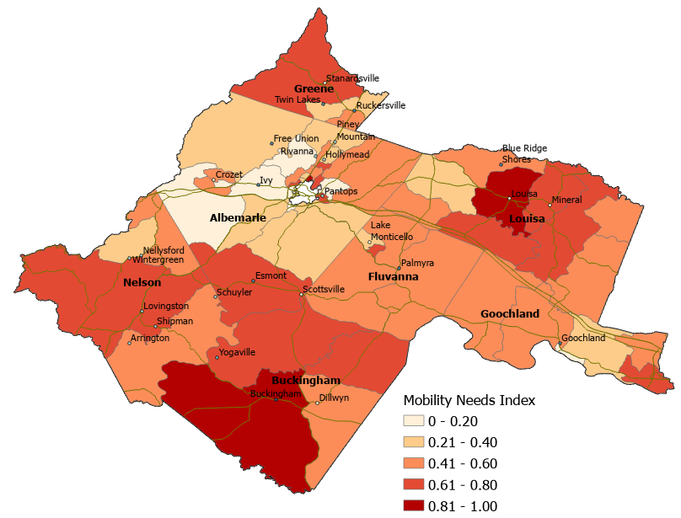
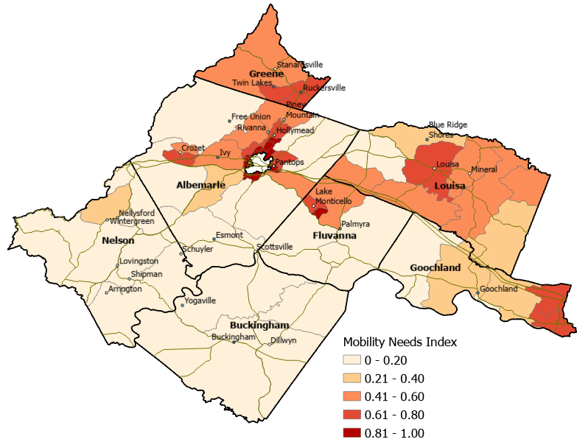
Mobility Needs Index
Based on Percentage of Population
Based on Population Density

Slide 15
Task 3. Describe and evaluate existing levels of passenger transportation services within the service area
Service description: Types of service, Span of service (days, hours, frequency)
Operating data
  Ridership
  Vehicle revenue miles
  Vehicle revenue hours
  Characteristics of riders
Financial data
Vehicles/facilities
Performance measures

Slide 16
Task 3. (continued)
Calculate per capita measures
  Trips per capita
  Vehicle revenue miles per capita
  Vehicle revenue hours per capita
Calculate measures per transportation disadvantaged population: trips per population aged 65 or older, trips per low-income population, etc.
Calculate measures at the county or census tract level where possible

Slide 17
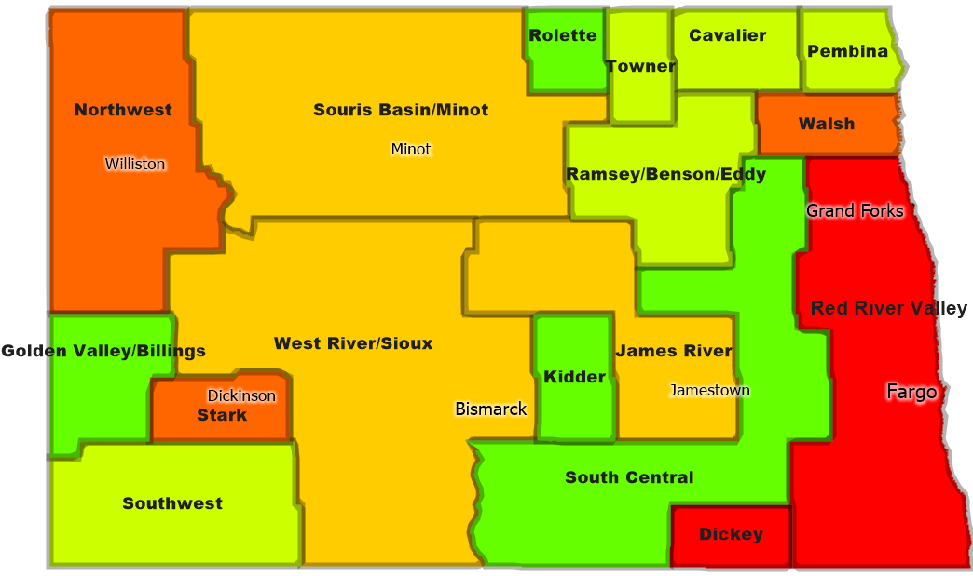
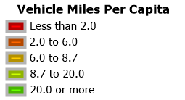
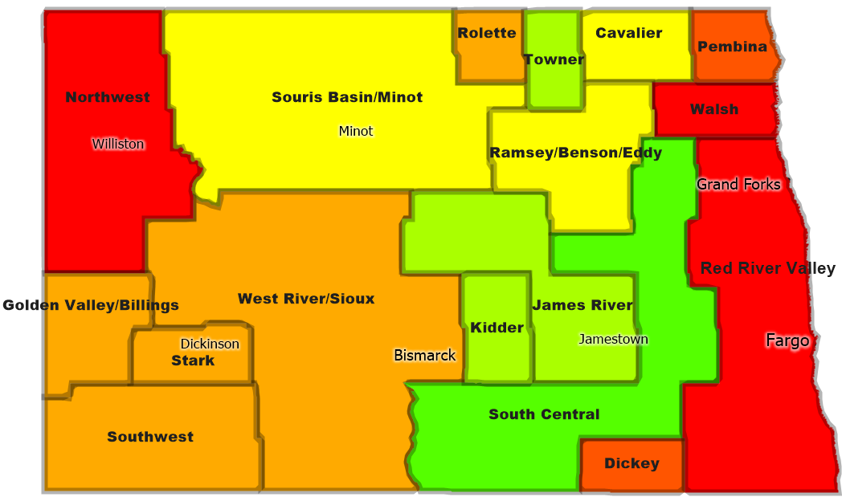
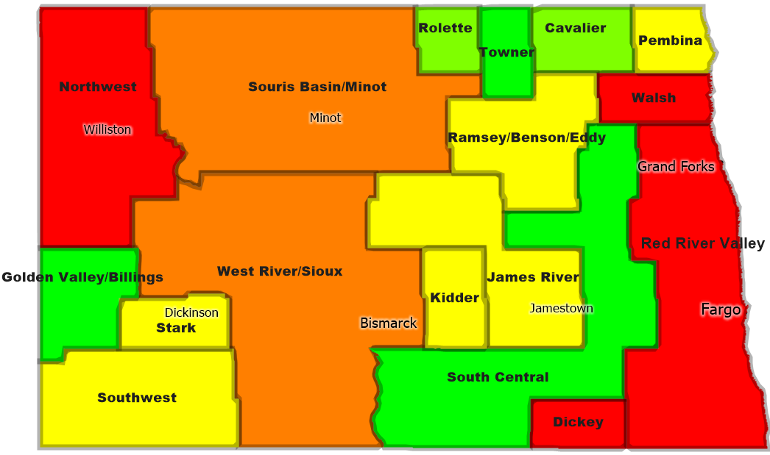
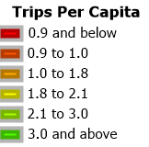
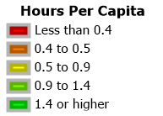
Example: Mapping Rural Service Levels Across North Dakota

Slide 18
Task 4. Establish mobility goals and identify service gaps, transit needs, and funding requirements
Identify goals or targets
  Peer analysis
  Stakeholder input
Compare performance/service levels to goals
  By county and by census tract
Identify service gaps
Calculate increased service needed to meet goals
  Consider different scenarios
  Account for projected population growth
  Calculate funding requirements

Slide 19
Task 5. Identify options and recommendations
Identify options for service improvements
Provide recommendations for where to prioritize service improvements
Seek feedback from stakeholders

Slide 20
Task 6. Prepare final report
Detailed research report
Summary report

Slide 21
Timeline
Task 2: Mostly completed
Task 3: Sept – Nov
Stakeholder meeting: Tentatively early December
Task 4: Nov – Jan
Task 5: Feb
Stakeholder meeting: Feb-March
Draft report completed around April
Final report completed by end of June

Slide 22
Discussion
Contact info:
Jeremy Mattson – jeremy.w.mattson@ndsu.edu
Jill Hough – jill.hough@ndsu.edu

